Slide 1

Group Presentation
Machine Learning Model Development

Slide 2

CONTENT
Diabetes Dataset (Dataset 1)
Introduction
EDA and Preprocessing
Feature Engineering
Model Training and Evaluation
Conclusion
Loan Dataset (Dataset 2)
Introduction
EDA and Preprocessing
Feature Engineering
Model Training and Evaluation
Conclusion

Slide 3
Introduction
This dataset is designed to predict whether a person is having diabetics or not.
This is a Classification problem
Key Features:
Glucose: Plasma glucose concentration (mg/dL).
Blood Pressure: Diastolic blood pressure (mm Hg).
Skin Thickness: Triceps skinfold thickness (mm).
Insulin: 2-hour serum insulin (mu U/ml).
BMI: Body mass index (weight in kg/(height in m)^2).
Diabetes Pedigree Function: A function that represents the genetic risk of diabetes.
Age: Age of the patient in years.
Pregnancies: Number of pregnancies (may indicate higher risk in women).

Slide 4
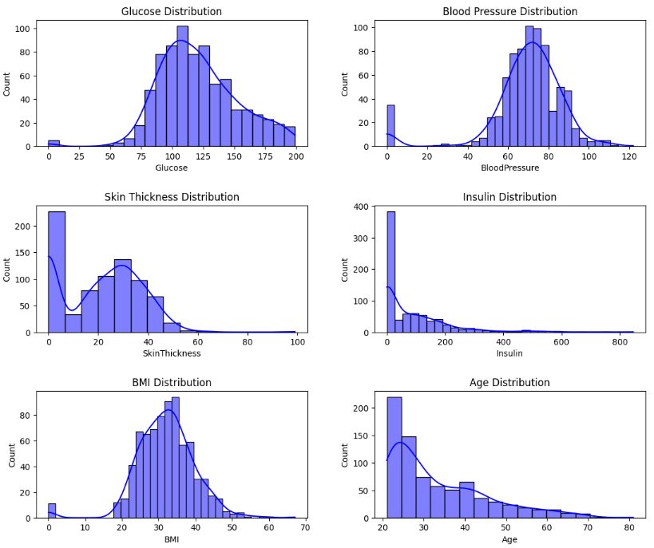
EDA and Preprocessing
EDA Process
Gain insights into the dataset by understanding patterns, distributions, relationships, and detecting anomalies
Visualize the spread of key features like Glucose, Insulin, BMI, Age, and Blood Pressure to identify skewness or normality.
Histograms help in spotting the concentration of data points across different ranges for each feature.
Observe potential patterns or anomalies such as gaps or spikes in data distribution, indicating possible outliers or data inconsistencies.

Slide 5
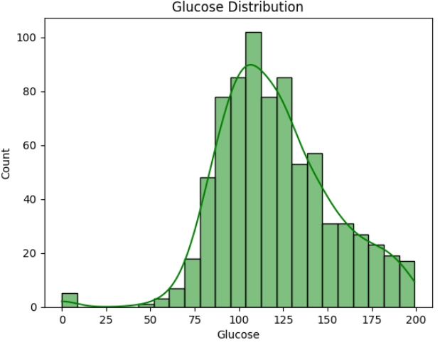
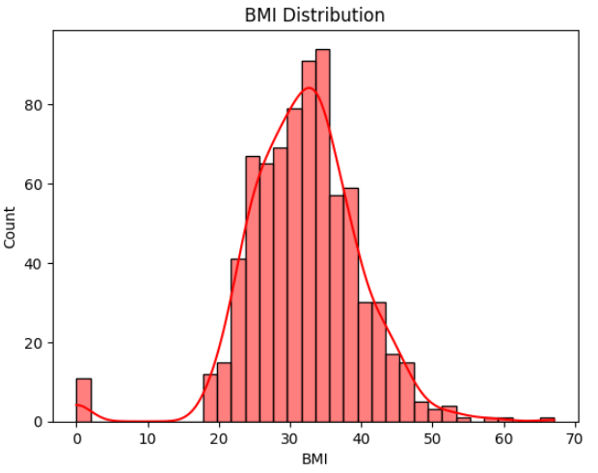
EDA and Preprocessing
Analyze features like Glucose and BMI to understand the proportion of diabetic vs. non-diabetic ranges.
Identify any features with strong or unusual peaks that might require transformation or further investigation.

Slide 6
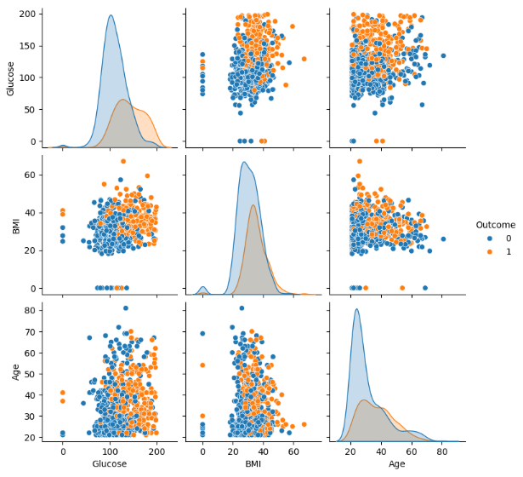
EDA and Preprocessing
Analyze feature distributions: Diabetic individuals cluster at higher Glucose and BMI values.
Glucose shows a right-skewed distribution for diabetic outcomes, while BMI has a less noticeable shift.
Scatter plots reveal potential linear relationships between Glucose and BMI, highlighting feature interactions for predicting diabetes.
Age displays a more dispersed relationship, indicating a weaker link with diabetes compared to Glucose and BMI.

Slide 7
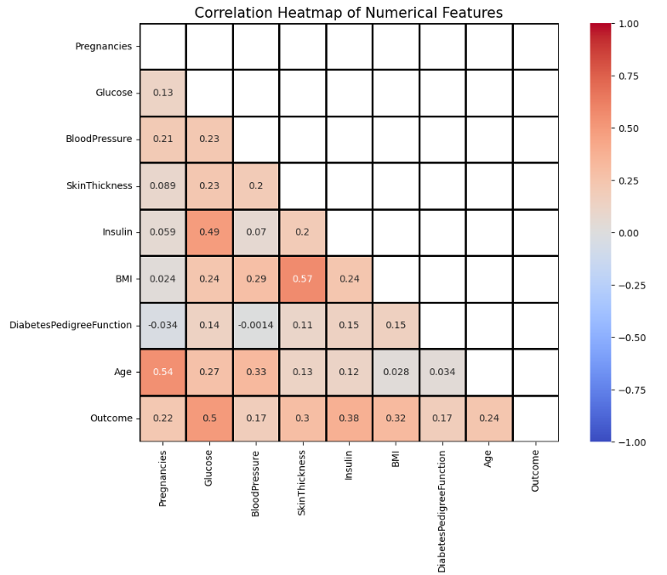
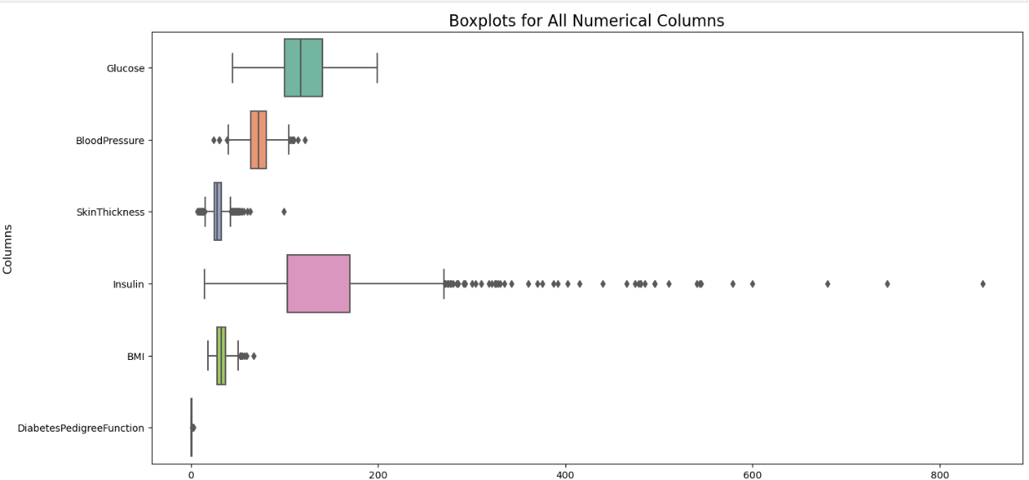
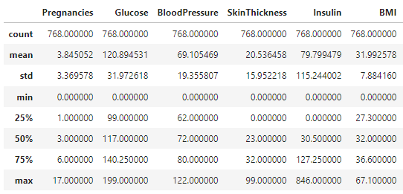
EDA and Preprocessing
EDA Process
Check basic statistics (mean, median, standard deviation, min/max) for key features like Glucose, BMI, and Insulin.
Correlation heatmap to show feature relationships.
Identify outliers for features using BOX Plots.
Most rows have 0 and they were identified as missing values

Slide 8
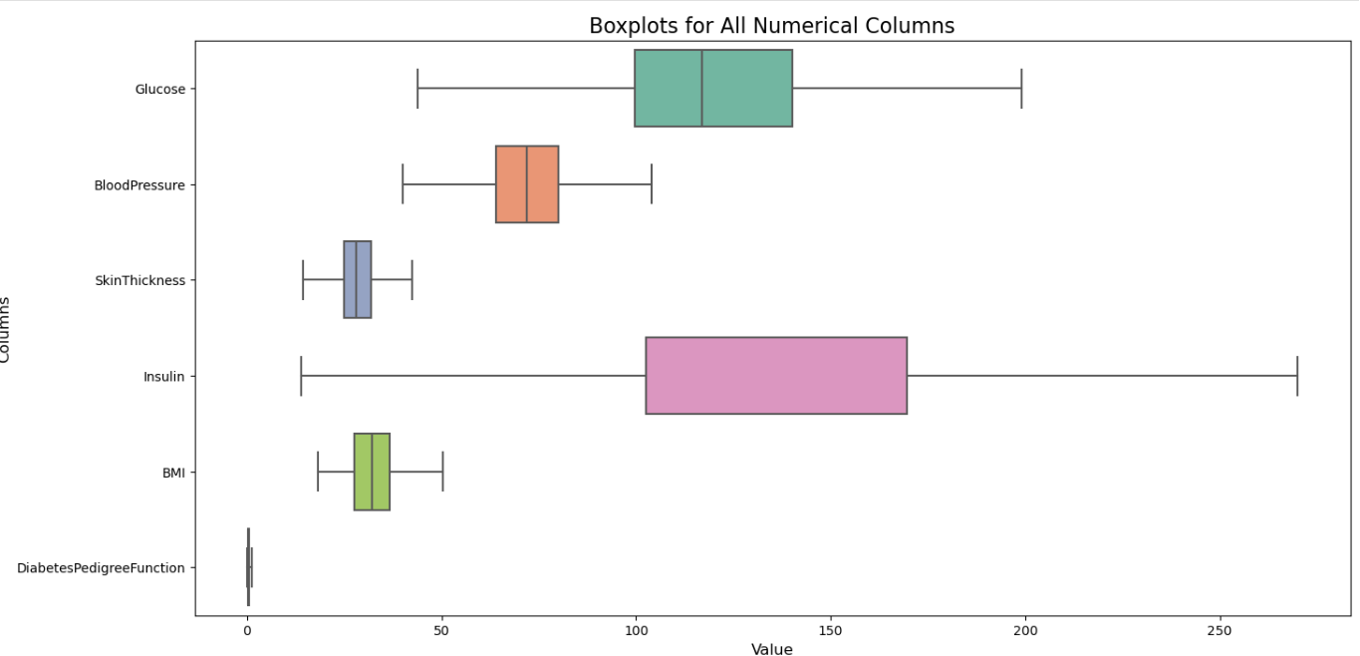
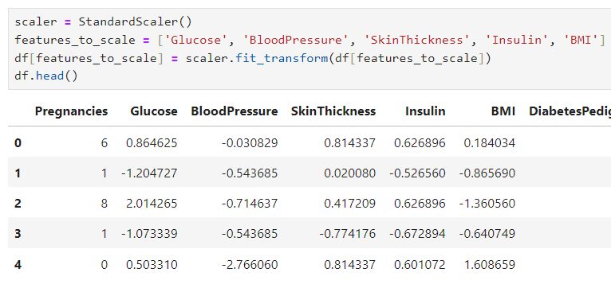
EDA and Preprocessing
Preprocessing
Replace all 0 values with Median.
Use Interquartile Range (IQR) method to detect and cap outliers, especially for features like Insulin and BMI.
Draw Box Plots again to confirm
Use Standardization to scale features like Glucose, BMI, and Insulin. This is important for models like KNN and SVM that rely on distance calculations.
Convert categorical data in to label encoding.

Slide 9
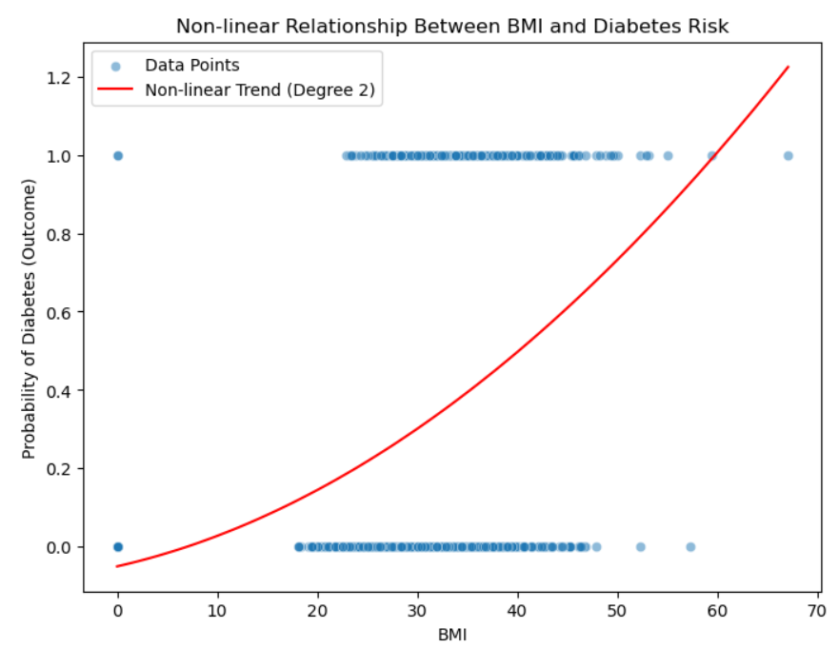
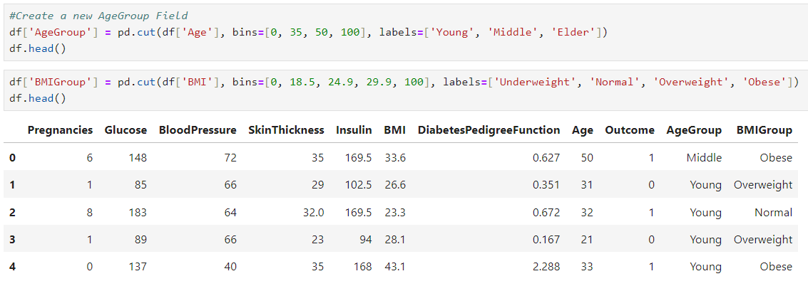
Feature Engineering
Age Grouping (Young, Middle-aged, Elderly)
Age is a continuous variable, and grouping it into categories like young, middle-aged, and elderly simplifies the complexity
BMI Categories (Underweight, Normal, Overweight, Obese)
By grouping BMI, we account for non-linear relationships between BMI and diabetes risk, which the model might miss if BMI is treated as a continuous feature.

Slide 10
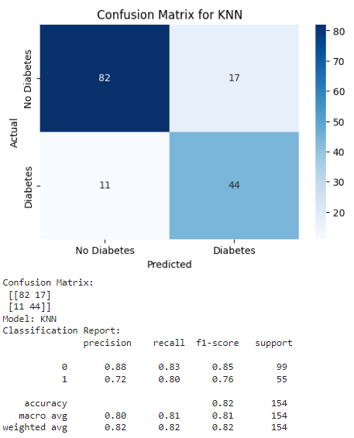
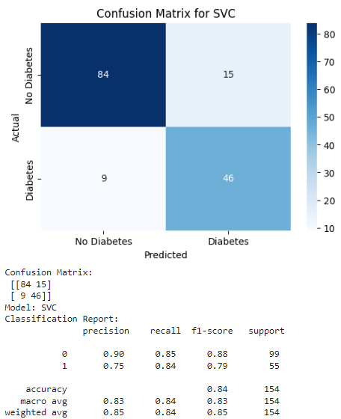
Model Training and Evaluation
We Tried with 5 types of Models
KNN
Logistic Regression
Decision Trees
SVC
Naive Bayes

Slide 11
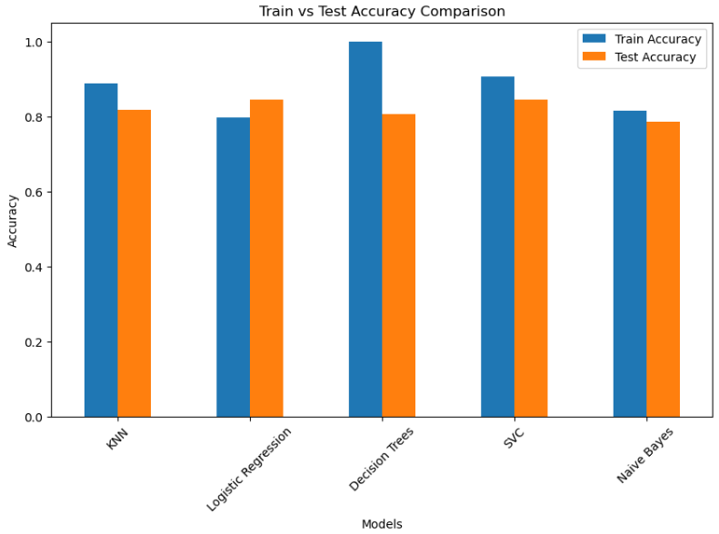
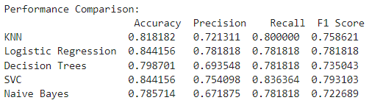
Conclusion
We Compare the Accuracy ,Precision, Recall ,F1 Score of each model
Draw graph to compare Train Vs Test Accuracy Graphs

Slide 12
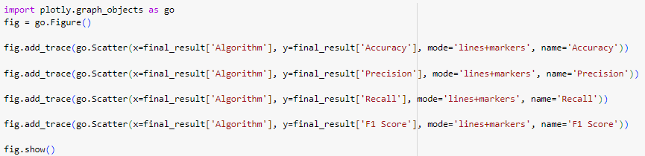
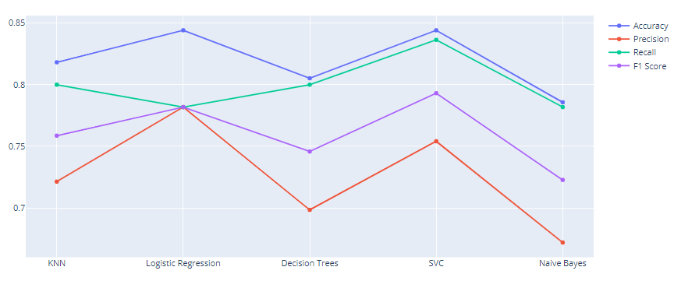
Conclusion
Model Comparison: Evaluated five models: KNN, Logistic Regression, Decision Trees, SVC, and Naive Bayes.
Best Performance: SVC and Logistic Regression showed the highest accuracy and recall.
Key Observations:
SVC excels across all metrics (accuracy, precision, recall, F1 score).
Logistic Regression performs consistently, with strong precision.
Naive Bayes has the lowest precision and F1 score, indicating poor handling of this dataset.
Decision Trees and KNN offer balanced but moderate performance.

Slide 13
Introduction
This dataset is designed to predict whether a loan will be paid off or not.
This is a Classification problem.
Key Features:
Principal: The amount of the loan granted.
Terms: The duration of the loan in days (e.g., 15 or 30 days).
Effective Date: The date when the loan started.
Due Date: The date when the loan is due to be repaid.
Age: The age of the borrower.
Education: The education level of the borrower, categorized into levels such as high school, bachelor’s, and college.
Gender: The gender of the borrower (male or female).

Slide 14
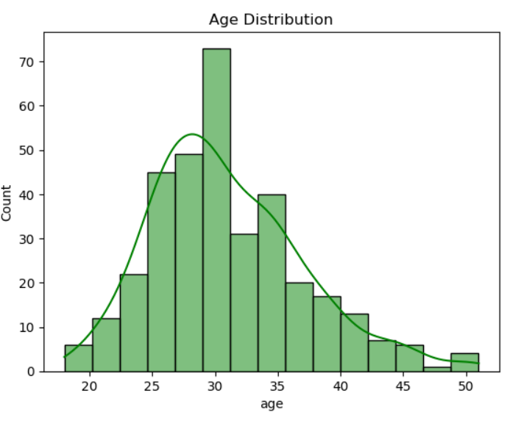
EDA and Preprocessing
EDA Process
Visualize the spread of key features like Principal, Age, and Terms to identify skewness or normality in the data.
Histograms help to spot the concentration of data points across different ranges for each feature, such as how many loans have specific principal amounts or loan durations.
Scatter plots reveal potential relationships between features, such as Principal vs. Age, to explore interactions that may influence loan repayment.

Slide 15
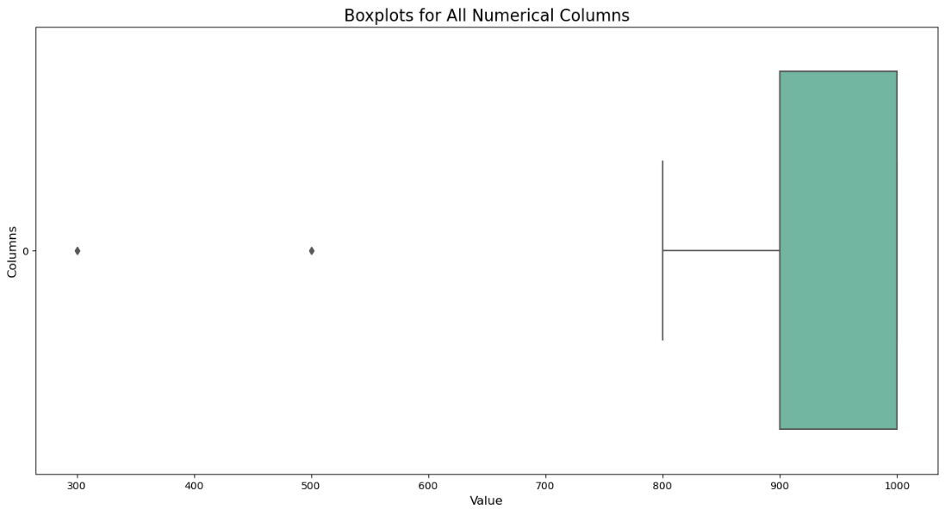
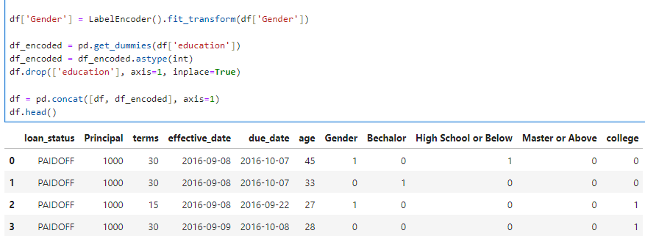
EDA and Preprocessing
Preprocessing
Convert Gender column in to label encoding and education to one hot encoding
Convert categorical variables into values
Handle two classes imbalance (PAIDOFF and COLLECTION)
Handle outlies of the Principal column using IQR

Slide 16
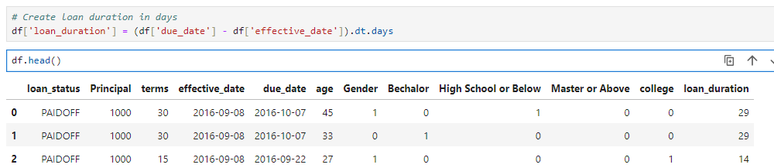
Feature Engineering
Loan Duration
Created new loan duration field using effective date and due date and remove loan duration field and drop effective date and due date columns

Slide 17
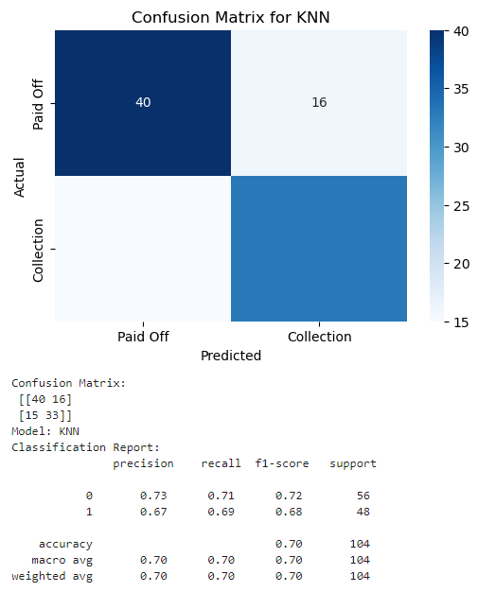
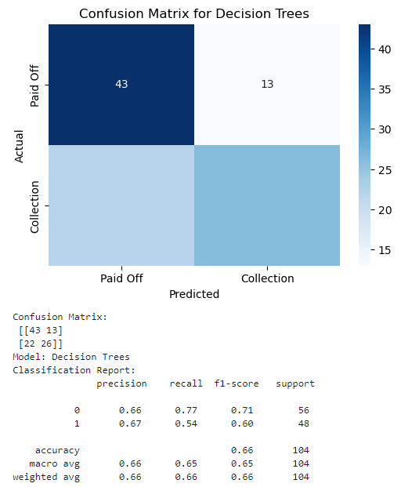
Model Training and Evaluation
Model Training and Evaluation
We Tried with 5 types of Models
KNN
Logistic Regression
Decision Trees
SVC
Naive Bayes

Slide 18
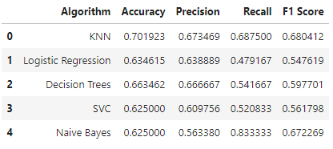
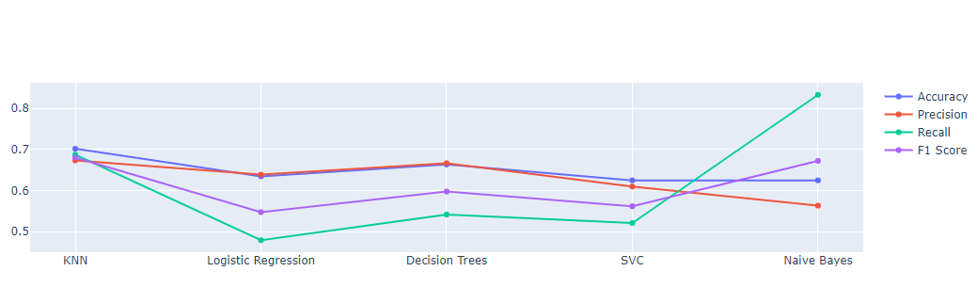
Conclusion
KNN had the highest accuracy (70.19%) and F1 score (0.68), making it the best performer overall
Naïve Bayes had the highest recall (83.33%) but lower precision, making it good for identifying more true positives
Each model had trade-offs , KNN balanced metrics well, while Naïve Bayes excellent in recall but had more false positives

Slide 19


